Slide 1
Introduction to Deep Learning

Slide 2
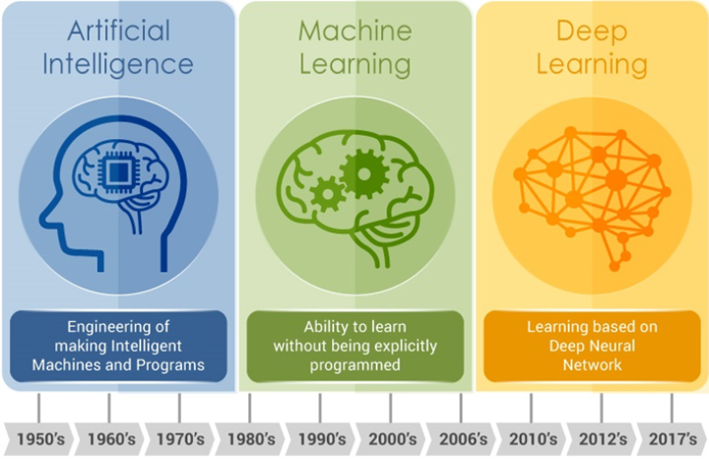
Difference between Artificial Intelligence (AI), Machine Learning (ML) and Deep Learning (DL)
Evolution of AI — Source: https://www.embedded-vision.com/

Slide 3
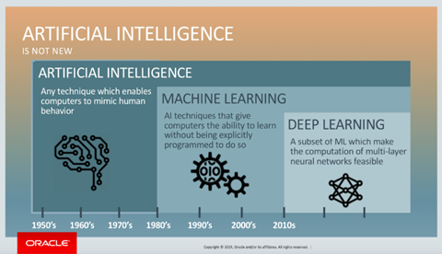
Where Deep Learning Lies

Slide 4
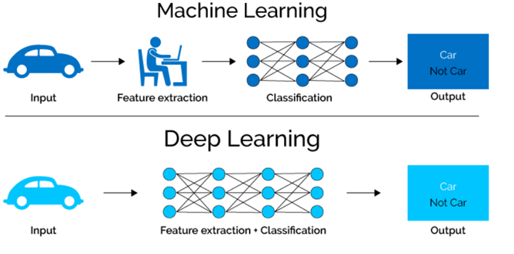

Slide 5
Deep learning
Deep learning is a set of learning methods attempting to model data with complex architectures combining different non-linear transformations. The elementary bricks of deep learning are the neural networks, that are combined to form the deep neural networks.
There exist several types of architectures for neural networks :
The multilayer perceptrons, that are the oldest and simplest ones
The Convolutional Neural Networks (CNN), particularly adapted for image processing
The recurrent neural networks, used for sequential data such as text or times series.

Slide 6
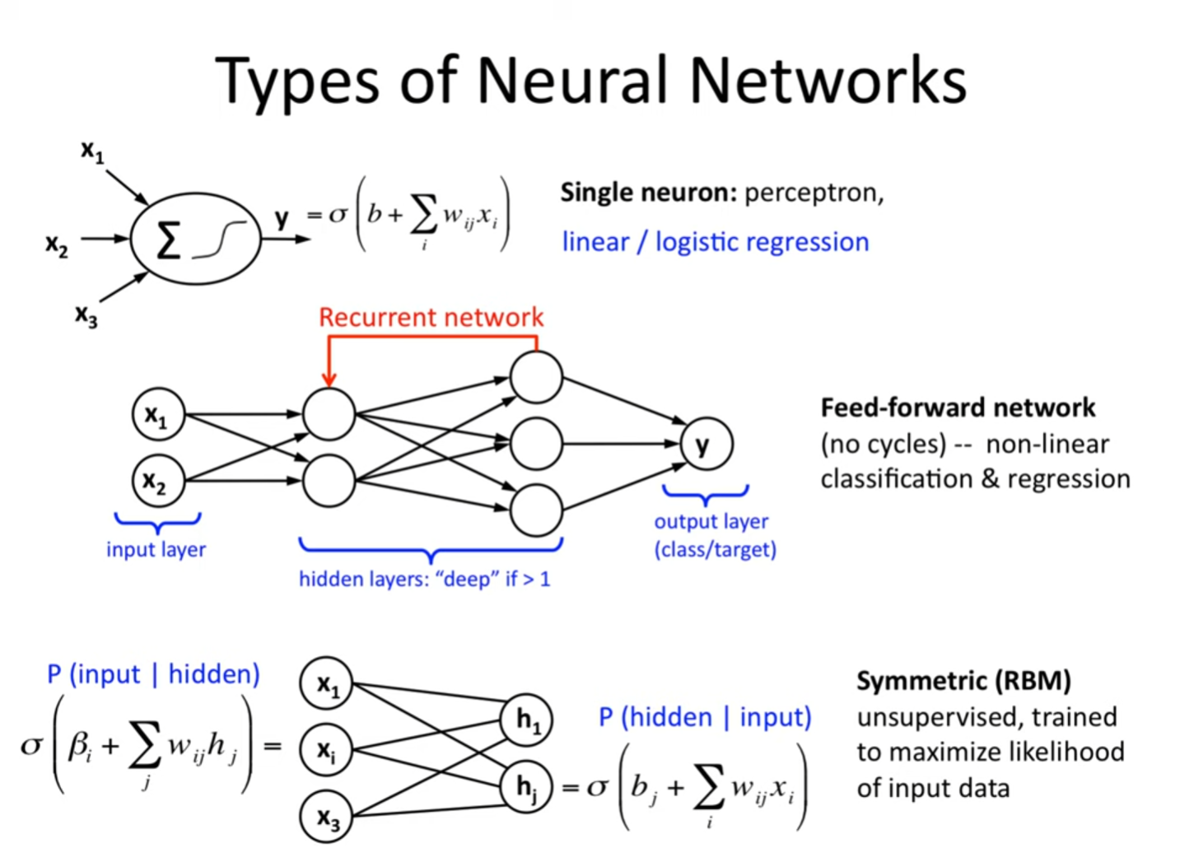

Slide 7
DEEP FEEDFORWARD NETWORK
Deep feedforward networks, also often called feedforward neural networks, or multilayer perceptrons (MLPs), are the quintessential deep learning models.
The goal of a feedforward network is to approximate some function f∗
For example, for a classifier, y = f∗(x) maps an input x to a category y.
A feedforward network defines a mapping y = f (x;θ) and learns the value of the parameters θ that result in the best function approximation.

Slide 8
These models are called feedforward because information flows through the function being evaluated from x, through the intermediate computations used to define f , and finally to the output y.
There are no feedback connections in which outputs of the model are fed back into itself. When feedforward neural networks are extended to include feedback connections, they are called recurrent neural networks.

Slide 9
Feedforward neural networks are called networks because they are typically represented by composing together many different functions.
The model is associated with a directed acyclic graph describing how the functions are composed together.
For example, we might have three functions f ⁽¹⁾ , f ⁽²⁾, and f ⁽³⁾ connected in a chain, to form f (x) = f ⁽³⁾(f ⁽²⁾ (f ⁽¹⁾(x))). These chain structures are the most commonly used structures of neural networks. The final layer of a feedforward network is called the output layer.
The overall length of the chain gives the depth of the model.

Slide 10
During neural network training, we drive f (x) to match f∗(x).
The training data provides us with noisy, approximate examples of f∗(x) evaluated at different training points.
The behaviour of the other layers is not directly specified by the training data.
The learning algorithm must decide how to use those layers to produce the desired output, but the training data does not say what each individual layer should do.
Instead, the learning algorithm must decide how to use these layers to best implement an approximation of f ∗.
Because the training data does not show the desired output for each of these layers, these layers are called hidden layers.

Slide 11
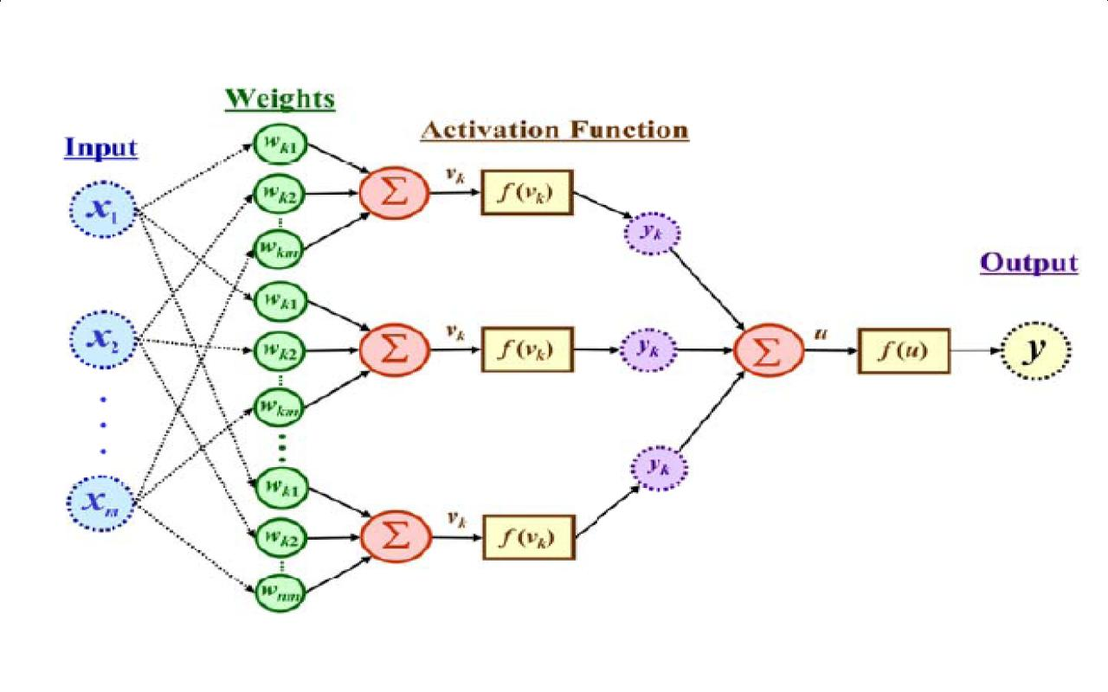
Feed forward neural network
  Input layer
  Output layer
  Hidden layer
  Neuron weights
  Neurons
  Activation Function

Slide 12
Input layer:
The neurons of this layer receive input and pass it on to the other layers of the network. Feature or attribute numbers in the dataset must match the number of neurons in the input layer.
Output layer:
According to the type of model getting built, this layer represents the forecasted feature.
Hidden layer:
Input and output layers get separated by hidden layers. Depending on the type of model, there may be several hidden layers.
There are several neurons in hidden layers that transform the input before actually transferring it to the next layer. This network gets constantly updated with weights in order to make it easier to predict.
Neuron weights:
Neurons get connected by a weight, which measures their strength or magnitude. Similar to linear regression coefficients, input weights can also get compared.

Slide 13
Weight is normally between 0 and 1, with a value between 0 and 1.
Neurons:
Artificial neurons get used in feed forward networks, which later get adapted from biological neurons. A neural network consists of artificial neurons.
Neurons function in two ways: first, they create weighted input sums, and second, they activate the sums to make them normal.
Activation functions can either be linear or nonlinear. Neurons have weights based on their inputs. During the learning phase, the network studies these weights.
Activation Function:
Neurons are responsible for making decisions in this area.
According to the activation function, the neurons determine whether to make a linear or nonlinear decision. Since it passes through so many layers, it prevents the cascading effect from increasing neuron outputs.

Slide 14
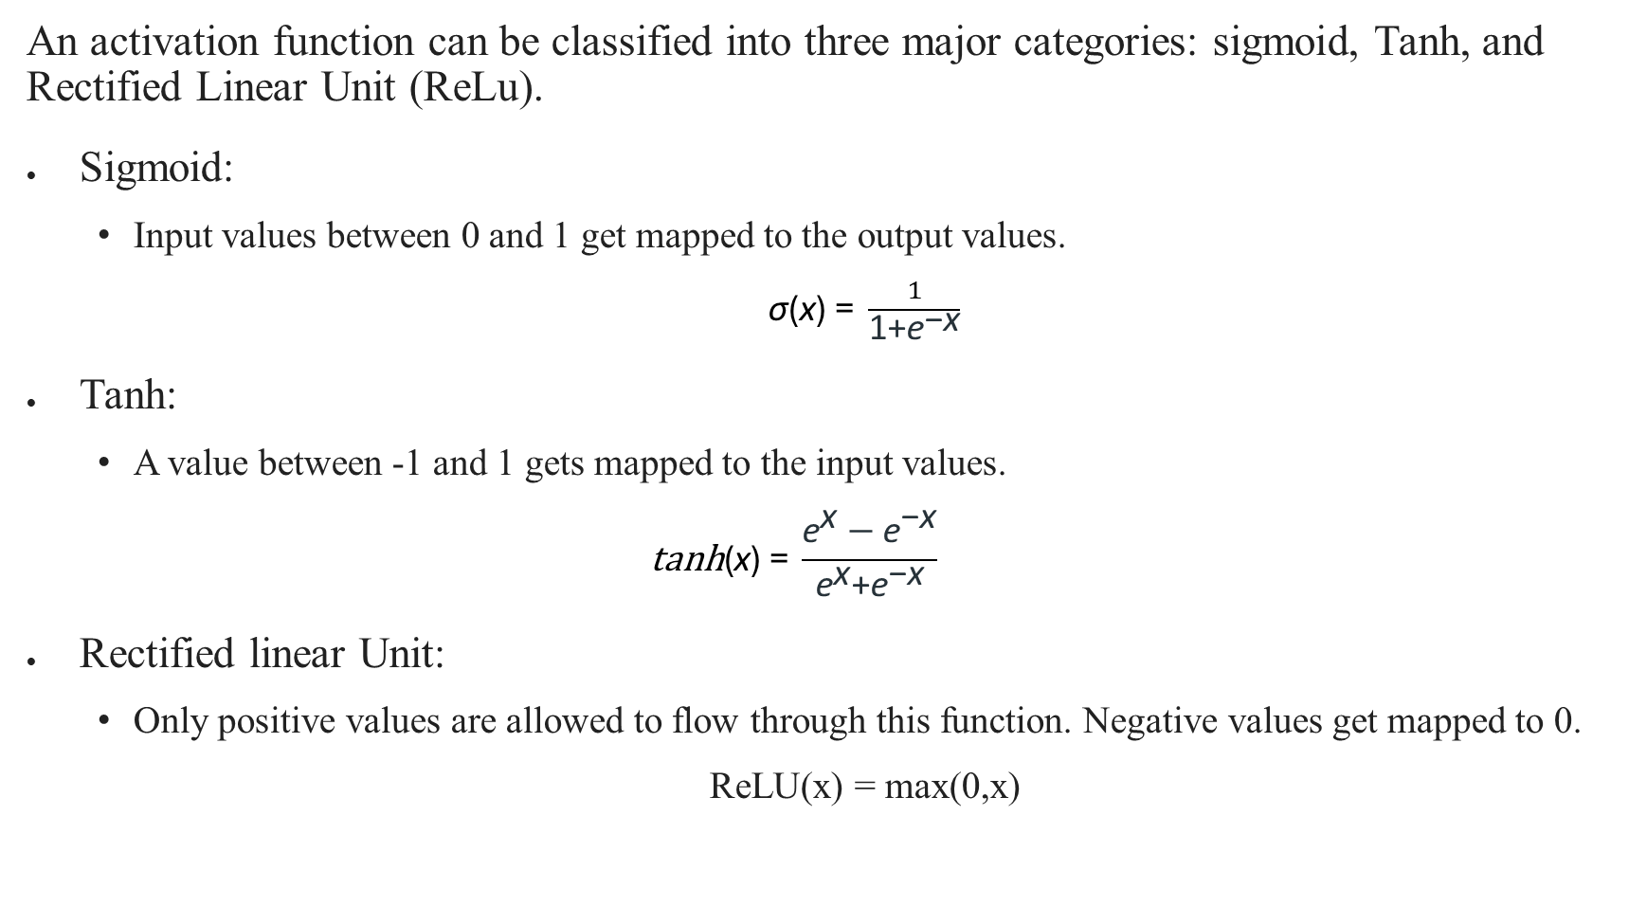
An activation function can be classified into three major categories: sigmoid, Tanh, and Rectified Linear Unit (ReLu).
Sigmoid:
  Input values between 0 and 1 get mapped to the output values.
  ​$\text{σ}\text{(}\text{x}\text{)} \text{=} \frac{1}{\text{1+}{\text{e}}^{\text{−}\text{x}}}$
Tanh:
  A value between -1 and 1 gets mapped to the input values.
  $$\text{t}\text{anh}\text{(}\text{x}\text{)} \text{=} \frac{{\text{e}}^{\text{x}}−{\text{e}}^{\text{−}\text{x}}}{{\text{e}}^{\text{x}}\text{+}{\text{e}}^{\text{−}\text{x}}}$$
Rectified linear Unit:
  Only positive values are allowed to flow through this function. Negative values get mapped to 0.
  ReLU(x) = max(0,x)

Slide 15
Functions in feed forward neural network
Cost Function
Loss Function
Gradient Learning Algorithm
Output Units

Slide 16

Cost function
In a feed forward neural network, the cost function plays an important role. The categorized data points are little affected by minor adjustments to weights and biases.
Thus, a smooth cost function can get used to determine a method of adjusting weights and biases to improve performance.
Following is a definition of the mean square error cost function:
Where, w = the weights gathered in the network; b = biases
n = number of inputs for training; a = output vectors;
x = input; ‖v‖ = vector v's normal length

Slide 17
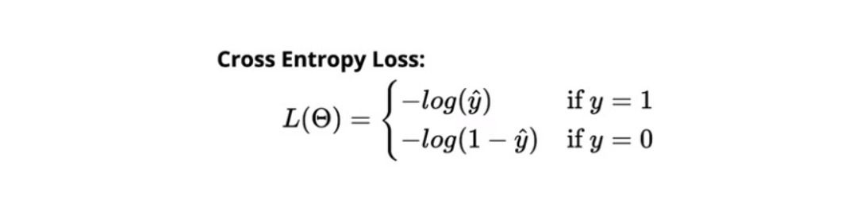
Loss function
The loss function of a neural network gets used to determine if an adjustment needs to be made in the learning process.
Neurons in the output layer are equal to the number of classes. Showing the differences between predicted and actual probability distributions. Following is the cross-entropy loss for binary classification.

Slide 18
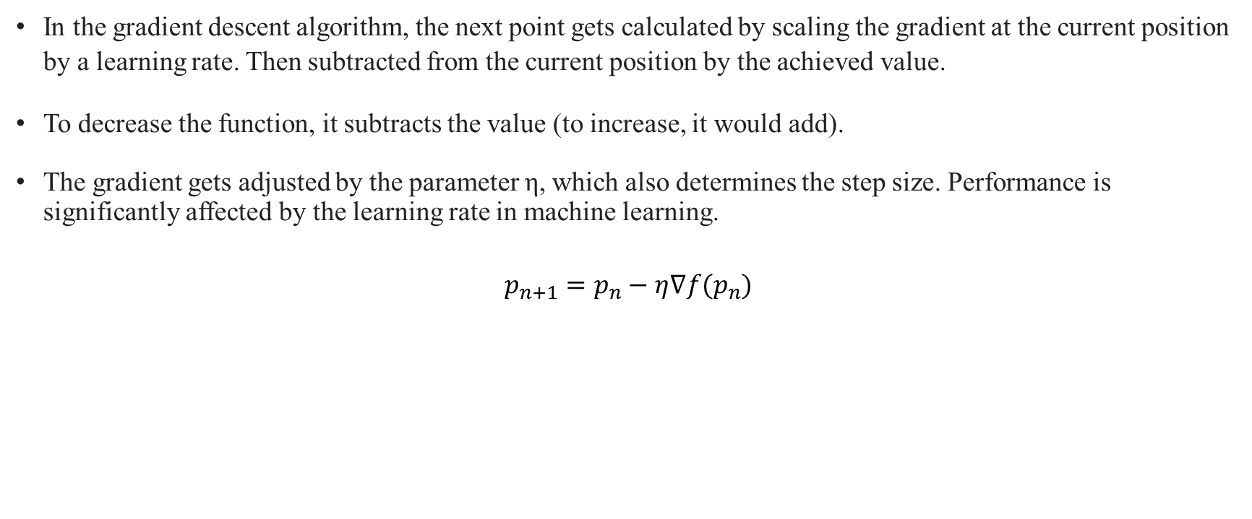
Gradient learning algorithm
In the gradient descent algorithm, the next point gets calculated by scaling the gradient at the current position by a learning rate. Then subtracted from the current position by the achieved value.
To decrease the function, it subtracts the value (to increase, it would add).
The gradient gets adjusted by the parameter η, which also determines the step size. Performance is significantly affected by the learning rate in machine learning.
$$p_{n+1}=p_{n}−η∇f(p_{n})$$

Slide 19
Output units
In the output layer, output units are those units that provide the desired output or prediction, thereby fulfilling the task that the neural network needs to complete.
There is a close relationship between the choice of output units and the cost function. Any unit that can serve as a hidden unit can also serve as an output unit in a neural network.

Slide 20
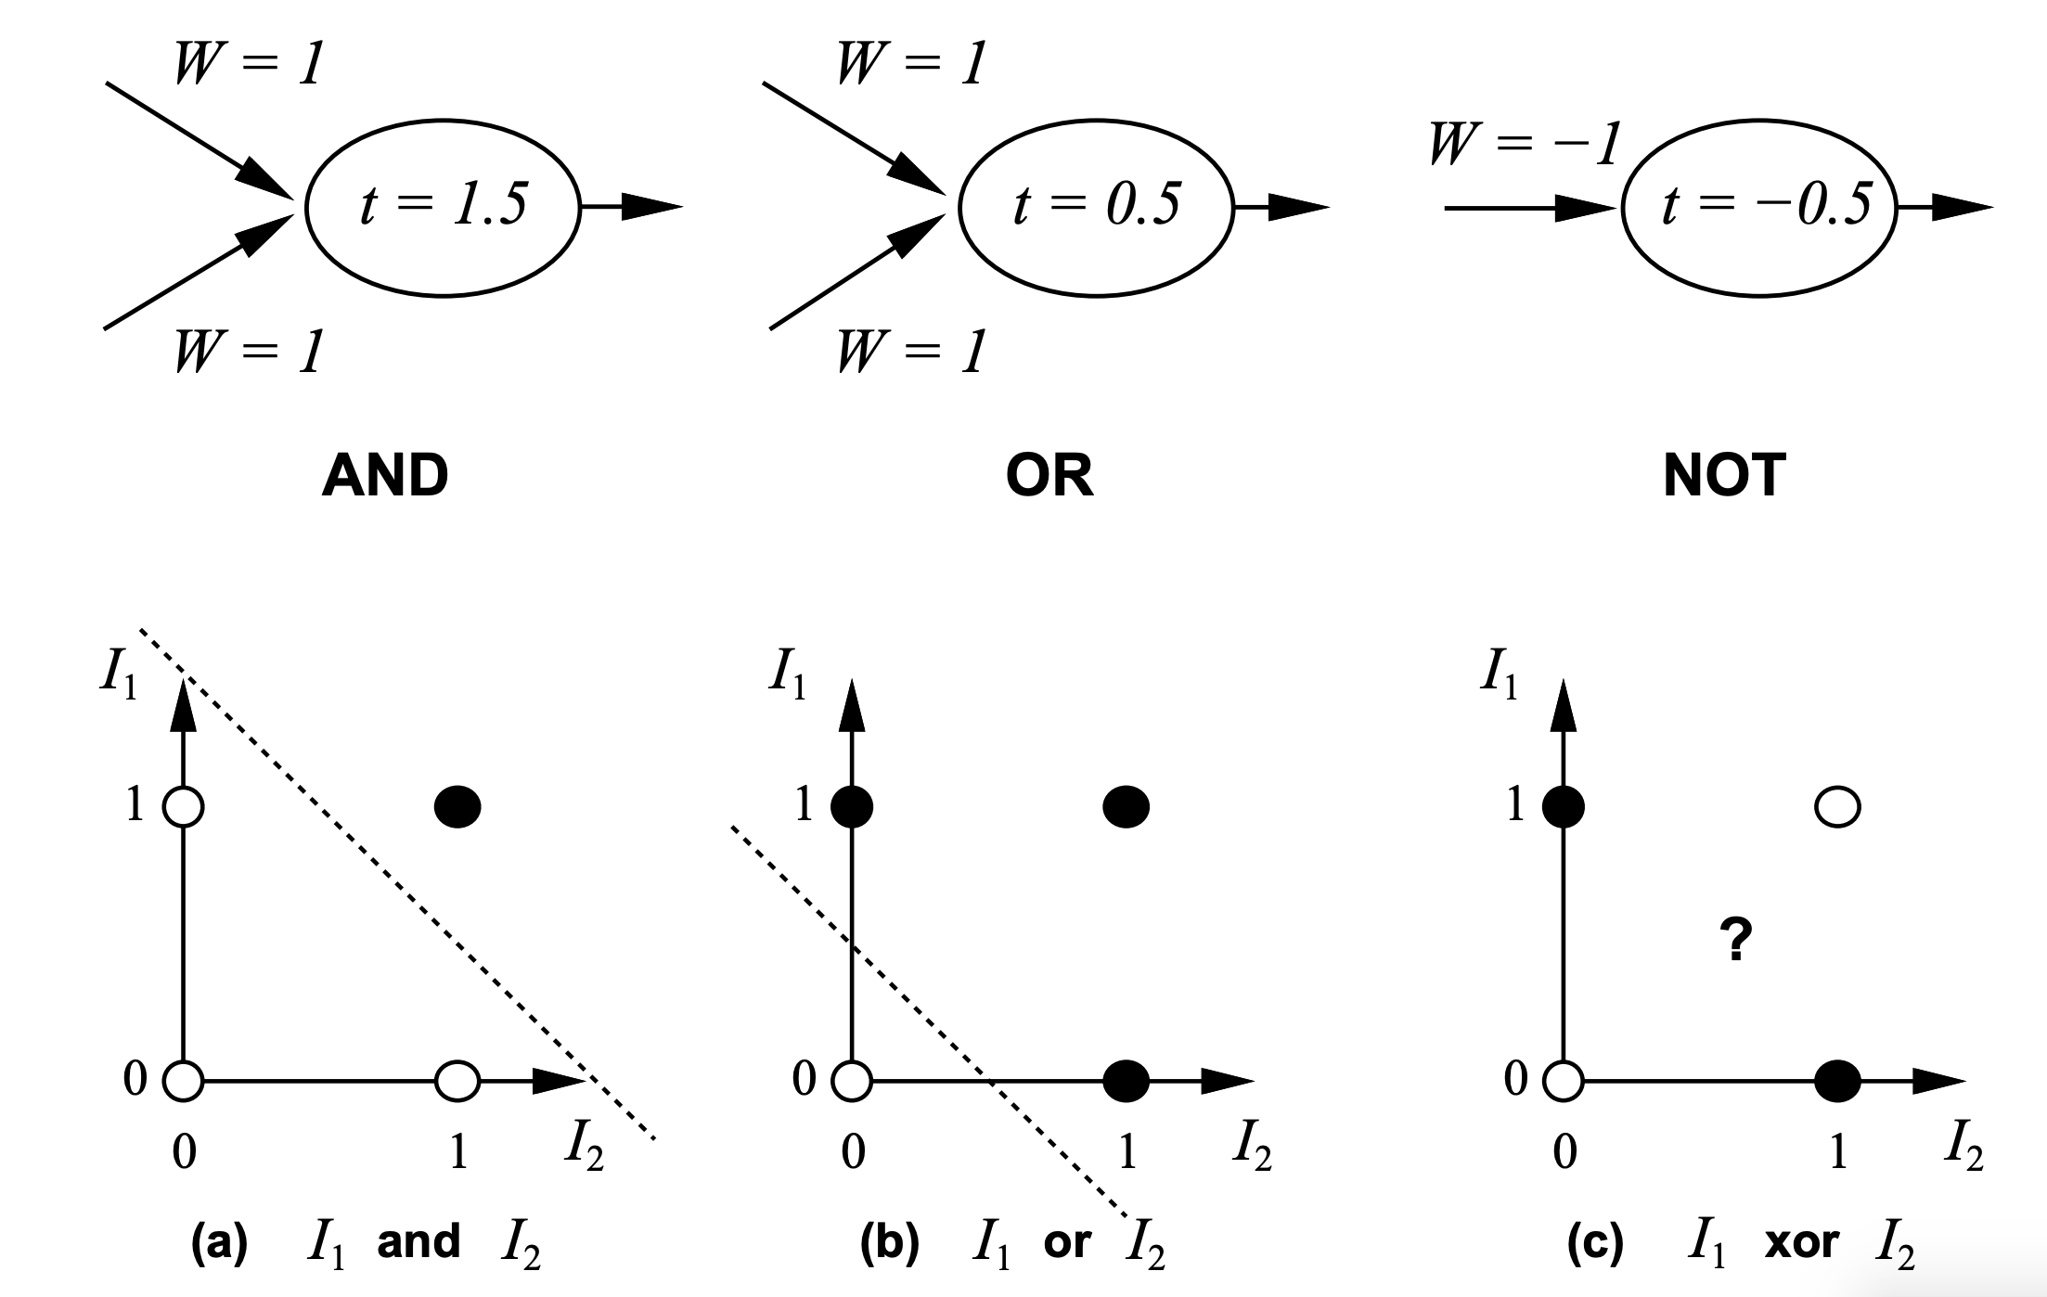
Example: Learning XOR
McCulloch and Pitts (1943) showed how linear threshold units can be used to compute logical functions

Slide 21
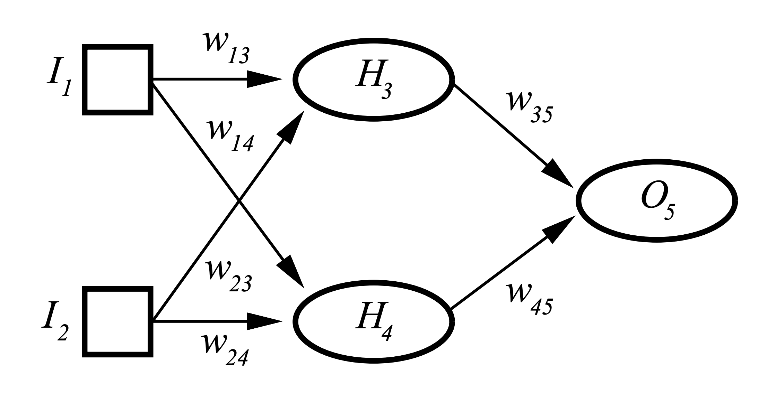
XOR

Slide 22
The XOR function provides the target function y = f∗ (x) that we want to learn.
Our model provides a function y = f(x;θ) and our learning algorithm will adapt the parameters θ to make f as similar as possible to f ∗.
We want our network to perform correctly on the four points X = {[0, 0]^{T}, [0, 1]^{T},[1, 0]^{T}, and [1, 1]^{T}}.
We will train the network on all four of these points. The only challenge is to fit the training set.
We can treat this problem as a regression problem and use a mean squared error loss function.
We choose this loss function to simplify the math for this example as much as possible. In practical applications, MSE is usually not an appropriate cost function for modeling binary data.

Slide 23

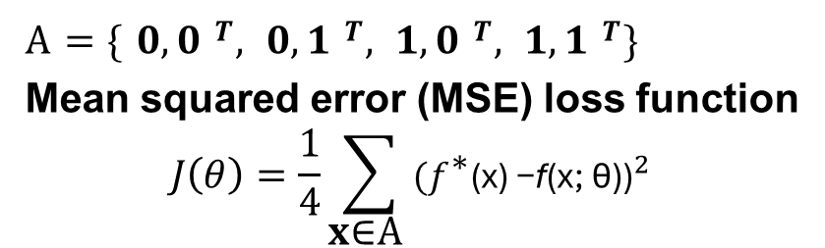
Example: Learning XOR
XOR function (“exclusive or”)
𝒙_{𝟏} 𝒙_{𝟐} 𝒙_{𝟏} 𝑿𝑶𝑹 𝒙_{𝟐}
0 0 0
0 1 1
1 0 1
1 1 0
A = { 𝟎, 𝟎 ^{𝑻}, 𝟎, 𝟏 ^{𝑻}, 𝟏, 𝟎 ^{𝑻}, 𝟏, 𝟏 ^{𝑻}}
Mean squared error (MSE) loss function
$$J\left(θ\right)=\frac{1}{4}\sum_{\text{x}\text{∈}\text{A} }{{{(f}^{\text{∗}}\text{(}\text{x}\text{) −}\text{f}\text{(}\text{x}\text{; }\text{θ}\text{))}}^{2}}$$
𝑓∗ (𝑥) : 𝑐𝑜𝑟𝑟𝑒𝑐𝑡 𝑎𝑛𝑠𝑤𝑒𝑟
𝑓(𝑥; 𝜃) : 𝑐𝑎𝑙𝑐𝑢𝑙𝑎𝑡𝑒𝑑 𝑟𝑒𝑠𝑢𝑙𝑡 𝑏𝑦 𝑛𝑒𝑢𝑟𝑎𝑙 𝑛𝑒𝑡𝑤𝑜𝑟𝑘

Slide 24
Now we must choose the form of our model, f (x;θ). Suppose that we choose a linear model, with θ consisting of w and b. Our model is defined to be f(x;w, b) = x ^{T} w + b.
We can minimize J(θ) in closed form with respect to w and b using the normal equations.
After solving the normal equations, we obtain w = 0 and b = ½.
The linear model simply outputs 0.5 everywhere.
A linear model is not able to represent the XOR function.
One way to solve
this problem is to use a model that learns a different feature space in which a linear model is able to represent the solution.

Slide 25
A linear model applied directly to the original input cannot implement the XOR function.
When x1 = 0, the model’s output must increase as x2 increases.
When x1 = 1, the model’s output must decrease as x2 increases.
A linear model must apply a fixed coefficient w2 to x2.
The linear model therefore cannot use the value of x1 to change the coefficient on x2 and cannot solve this problem.

Slide 26
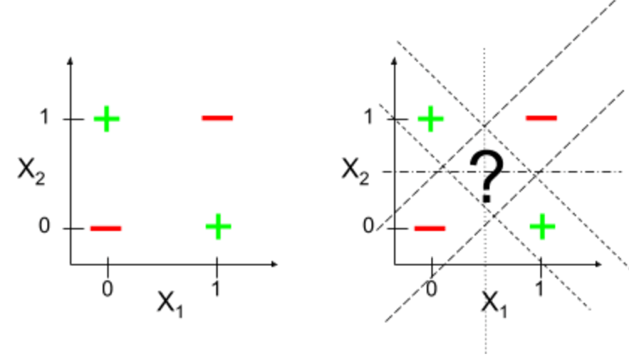

Slide 27
we will introduce a very simple feedforward network with one hidden layer containing two hidden units.
This feedforward network has a vector of hidden units h that are
computed by a function f ⁽¹⁾(x;W, c).
The values of these hidden units are then used as the input for a second layer.
The second layer is the output layer of the network.
The output layer is still just a linear regression model, but now it is applied to h rather than to x .
The network now contains two functions chained together: h = f(¹⁾(x;W, c) and y = f⁽²⁾⁽h;w, b), with the complete model being
f(x;W, c,w, b) = f⁽²⁾(f ⁽¹⁾(x)).

Slide 28









Example: Learning XOR
ℎ = 𝑔(𝑤^{𝑇}𝑥 + 𝑏)
M
𝑤^{𝑇}𝑥 + 𝑏
M
𝑤_{M}
𝑤_{N}
𝑥
M
ℎ_{M}
𝑓(𝑥; 𝜃)
𝑥_{N}
ℎ_{N}
𝑤^{𝑇}ℎ + 𝑐
N
Input layer
Hidden layer
Output layer
(g = activation function, b, c = bias)
𝑓 𝑥; 𝜃
= 𝑓 𝑥; 𝑤_{M}, 𝑏, 𝑤_{N}, 𝑐 = 𝑤^{𝑇}𝑔 𝑤^{𝑇}𝑥 + 𝑏 + 𝑐
N M

Slide 29
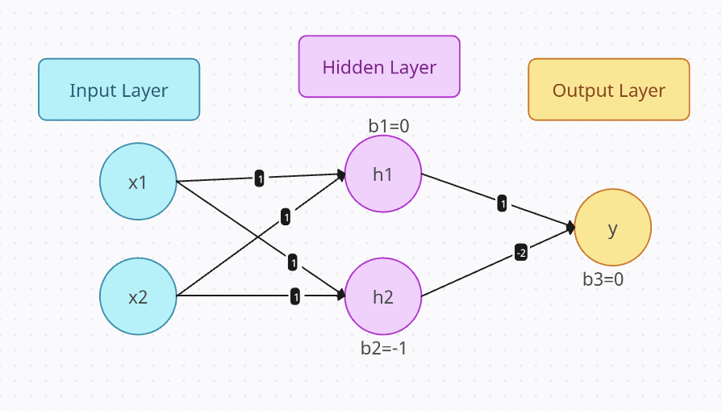
Example :

